Slide 1
Making it Count
Investment Outlook & Portfolio Implications
David Griffith, Director, Senior Investment Strategist
March 2015

Slide 2
Learning outcomes for this session
  Investment outlook for 2015,
      Where are the opportunities?
      What are the risks?
  Multi Asset Portfolio Construction
      Advanced techniques for portfolio construction; SAA, TAA, SS
      Insight into the theory behind these techniques
  How to convert market views into implementable portfolios in a structured way
  Investigate risk management techniques to stress test portfolios
Notes:
Notes
The learning outcomes for today’s presentation cover 4 main areas:
Firstly we’ll take a look at the investment outlook for 2015, specifically where are the opportunities and what are the risks?
We’ll then turn our attention to how can build more robust Multi asset portfolios by exploring several different techniques and the theory behind these techniques
We’ll also look at how we convert our short and long term asset class views into implementable portfolios
Finally we’ll explore some risk management techniques to stress test portfolio’s

Slide 3
BlackRock Investment Outlook 2015

Slide 4
2014: The Scorecard
Asset Class Returns 2014
Source: Thomson Reuters, BlackRock Investment Institute, December 2014
Notes:
Notes
Firstly lets take stock of what we observed in 2014:
Equity markets enjoyed another reasonably solid year, S&P 500 up 15%, Japanese equities up 10%, MSCI world +6%.
This result wasn’t entirely unexpected given investors anticipation for further policy support from central banks
What really took the market by surprise in 2014 was the continued fall in global bond yields when most expected yields, at least in the US to rise in 2014
Late in the year we had the dramatic decline in energy prices as a glut of new supply came online, particularly in the US from new extraction technologies.
So with that context in mind lets turn our attention to what may be in store for the year ahead

Slide 5
Global Recovery: This Time is Different
Current vs. Past Recoveries from Recession, 1960 - 2014
Years before recession
Years after recession
Sources: Thomson Reuters, Datastream, BlackRock Investment Institute, and IMF, November 2014
Notes:
Notes
Clearly the recovery that we have witnessed since the GFC or “great recession” has been slower than past recoveries
While we have seen positive growth momentum in the US in recent periods, clearly growth in the rest of the world remains challenged, particularly the Eurozone.
Closer to home, clearly a slowing China has dampened the outlook for growth in Australia, the RBA is recognising this

Slide 6
Diverging Growth
United States
Euro zone
Japan
China
Euro zone Countries
Australia
Source: Thomson Reuters, BlackRock Investment Institute, February 2015
Notes:
Notes
A theme that we are seeing across both Developed and Emerging economies is that of divergence
These charts show year on year GDP growth in the major economies
As you can see, growth in the US and to some extent the UK has been positive but below trend
While on the other side of the coin growth in Europe, Japan and China has been slowing
It is BlackRock’s view that we will continue to see this divergence in growth across economies and regions for some time to come

Slide 7
US outperformance vs rest of the world but is this changing?
Global Manufacturing Activity
Source: Thomson Reuters, BlackRock Investment Institute, February 2015
Notes:
Notes
The divergence in US growth from the likes of Europe and China is seen more clearly here in terms of manufacturing activity
More recently, we’re seeing some of this positive momentum rolling over
The US Fed would be watching this closely and hoping that sluggish growth in other parts of the world doesn’t drag down US growth.

Slide 8
Global Inflation
Inflation Ex Food and Energy
Source: Thomson Reuters, BlackRock Investment Institute, February 2015
Notes:
Notes
Global central banks also have a very close eye toward inflation and inflation expectations in their respective regions
Looking at this chart, it’s a bit of a race to the bottom
Inflation in Europe is scarily low, converging to zero which is why the ECB has just embarked on their own Quantitative Easing program to stave off the threat of deflation
While central banks don’t like elevated levels of inflation, they also don’t like negative inflation as this has implication on consumption and investment expectations, spending activity and ultimately growth (eg. Japan has been stuck in a deflationary rut for much of the last 20 years).

Slide 9
All eyes on FOMC in 2015
FOMC Appropriate timing of first rate increase
Number of Participants
Source: Monetary Policy Report, US Federal Reserve, February 2015
Notes:
Notes
Clearly one of the most anticipated events of 2015 for financial markets will be whether the US Fed increases interest rates for the first time since cutting rates close to zero
Clearly the US economy has come along way in terms of progress with growth and employment conditions
Many of the preconditions the Fed had set for a “lift off” in rates have eventuated
Clearly all eyes will be on the Fed policy meetings in 2015 in anticipation of the first move
Why is this important?

Slide 10
Policy matters
US Equities and QE
$Trillion
Source: Thomson Reuters Datastream, US Federal Reserve, BlackRock Investment Institute, February 2015
Notes:
Notes
Clearly policy has been an important driver of asset prices in recent years
We will be entering uncharted waters when the Fed ultimately pulls the trigger on raising rates
Equity valuations are getting stretched and earnings growth has not kept pace
There is a risk this is the catalyst for a correction

Slide 11
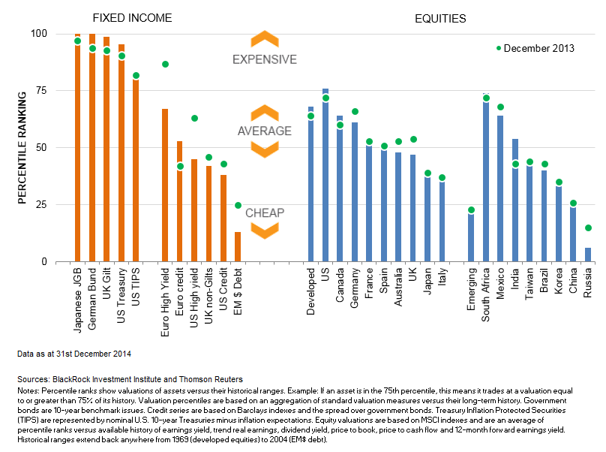
Asset Valuations vs Historic Norm
Fixed Income
Equities
100
75
50
25
0
December 2013
Percentile Ranking
Date as at 31 December 2014
Source: Thomson Reuters Datastream, US Federal Reserve, BlackRock Investment Institute, February 2015
Notes: Percentile ranks show valuations of assets versus their historical ranges. Example: If an asset is in the 75th percentile, this means it trades at a valuation equal to or greater than 75% of its history. Valuation percentiles are based on an aggregation of standard valuation measures versus their long-term history. Government bonds are 10-year benchmark issues. Credit series are based on Barclays indexes and the spread over government bonds. Treasury Inflation Protected Securities (TIPS) are represented by nominal U.S. 10-year Treasuries minus inflation expectations. Equity valuations are based on MSCI indexes and are an average of percentile ranks versus available history of earnings yield, trend real earnings, dividend yield, price to book, price to cash flow and 12-month forward earnings yield. Historical ranges extend back anywhere from 1969 (developed equities) to 2004 (EM$ debt).
Notes:
Notes
Speaking of valuations, this chart shows valuations of various asset classes, both equities and bonds versus their historic norm over the last 10 years
Fixed income assets appear most stretched on this metric
Equity markets are by no means cheap
We may all need to reset our expectations for returns for our portfolio’s in the period ahead
It also points to the need for diversification away from these traditional asset classes in order to drive future returns

Slide 12
Historic Asset Volatility
US Equities
US 10yr Treasury
US Dollar
Brent Crude
Source: Thomson Reuters Datastream, US Federal Reserve, BlackRock Investment Institute, February 2015
Notes:
Notes
Something else to keep an eye on in 2015 is asset price volatility
Volatility across almost all asset classes has been suppressed in recent years
We believe this low volatility environment may be changing
We have already started to see volatility creep back into markets in late 2014

Slide 13
Correlations - a new normal or correction looming?
Correlation of Bond and Equity Returns
QE Tapering Announced
Source: Thomson Reuters Datastream, US Federal Reserve, BlackRock Investment Institute, February 2015
Notes:
Notes
We have also enjoyed a period of negative correlations between equities and bonds over the past few years
Our portfolio appear to have been well diversified
There is a risk that we go back to an environment of positive correlation, which will make it harder to achieve portfolio diversification in the future

Slide 14
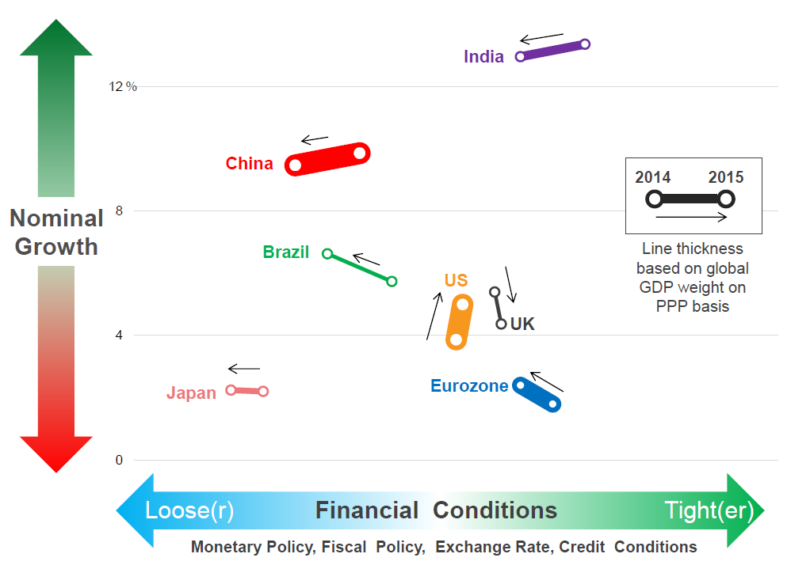
Base case for 2015
Our base case for 2015 is a world of divergence in terms of economic growth and monetary policy
  Slightly tighter financial conditions in the US and UK, while looser policies mostly elsewhere
Source: BlackRock Investment Institute, as of November 2014. Note: Nominal Growth forecasts from IMF World Economic Outlook
Notes:
Notes
To summarise, our economic base case for 2015 is that of economic divergence between economies, which also means divergence in policy outcomes
We expect both these forces to play a dominant role in asset prices in 2015
It may also represent opportunities for active strategies that can position for divergence

Slide 15
Assessment Question
What is the likely outlook for asset class volatility and correlations going forward?
  Higher volatility, lower correlations
  Lower volatility, higher correlations
  Higher volatility, higher correlations
  Lower volatility, lower correlations

Slide 16
Implications for Portfolio Construction
Notes:
The upshot of this is that we should all be thinking about how we can make our portfolios work harder both in terms of boosting returns but also to diversify risk
In other words, how can we “Make it Count” to use the theme of the conference

Slide 17
Portfolio Construction - what matters?
Asset Allocation explains around 90% of a funds variability in returns*
Security Selection (SS)
Tactical Asset Allocation (TAA)
Strategic Asset Allocation (SAA)
*Source: Determinants of Portfolio Performance, Brinson, Hood and Beebower, 1986
Notes:
Notes
So when were constructing portfolios, its useful to understand what really “counts” in terms of what drives portfolio returns
There have been many academic studies over the years exploring this, the first and probably most notable analysis is that from Brinson, Hood and Beebower in 1986. Their findings showed that the strategic allocation of a portfolio explained upwards of 90% of the variability in portfolio returns. This figure has been debated and scrutinized in further studies by Ibbotson who claim its more like 75%).
Either way, a portfolio’s strategic asset mix is clearly an important driver of returns, as such its worth focusing our time on getting this right (as much as you can without perfect foresight).
We also believe you can add significant value from Tactical Asset Allocation and also security selection, but not all active returns are created equally, it’s a matter of choosing the right type of active returns…..I’ll explain what I mean a little later in the presentation.

Slide 18
Portfolio Construction - 4 Step Process
1. Determine Strategic
Asset Allocation
Establish long term assumptions for each asset class
Build candidate SAA’s with appropriate characteristics
Stress Test SAA’s
2. Determine sources of
Active Return
Tactical Asset Allocation across asset classes
Security selection within asset classes
Choose strategies that optimise use of risk Budget
3. Construct portfolio
combing SAA + Alpha
Efficient use of capital, use derivatives to free up capital for alpha strategies
Cost effective implementation of market beta’s
4. Measure, monitor
and manage Risk
Measure and monitor risks, stress and scenario testing
Implement changes accordingly
Source: BlackRock
Notes:
Notes
Here I present a framework for portfolio construction:
Step 1 is to determine the appropriate policy mix, ie the Strategic, or long term asset allocation (ie the key driver of returns)
Step 2 is to explore how we can add value above an beyond the strategic allocation either via Tactical Allocation or security selection
Step 3 brings the strategic allocation together with the active returns sources, taking into account implementation cost and efficient use of capital
And finally, Step 4 involves measuring and managing risk both of the original portfolio, but with feedback through time

Slide 19
1. Determine Strategic Asset Allocation
I. Derive Asset Class Assumptions
A. Macro Forecasts
Metric | Derivation | US | EU | UK | JP | EM
Real GDP | Trend growth forecasts, labour force growth & productivity. | 2.5% | 1.5% | 2.0% | 1.0% | 4.0%
Inflation | On average central Banks meet inflation targets | 2.3% | 1.5% | 2.0% | 1.5% | 4.0%
Real Rates | Assume long term equilibrium real rate of 2% | 2.0% | 2.0% | 1.0% | 1.0%
P/E | P/E representing fair value for each region | 17.5 | 16.5 | 14.5 | 16.5 | 14.0
Earnings Trend | Potential earning growth | Above | Below | Below | Neutral | Below
Source: BlackRock, illustrative example only
Notes:
Notes
Step 1. – How do you arrive at the appropriate Strategic Allocation?
-The first step is to establish some return forecasts for the universe of investable assets at your disposal.
-Typically asset class returns are derived from forecast of economic fundamentals.
- Here’s an example of our economic forecasts for some major economies with a 5 year time horizon
-There is a framework for forecasting each of these macro variables, but we essentially distil this into our forecast for GDP growth, inflation, rates, Price Earnings ratios and earnings trends which are important for forecasting equity returns
We estimate long-term sustainable real GDP growth, which in turn is determined by labour force growth and productivity. Since these influences tend to change slowly over time, changes for the forecasts in these trends are also slow moving. Allowance is also made for material estimated deviations between the current level of economic activity and the estimated trend, we generally assume mean reversion to trend over the 5 year period.
At present, we assume somewhat lower sustainable long-term growth rates than in the past, reflecting demographic trends and somewhat lower productivity growth.

Slide 20
1. Determine Strategic Asset Allocation
I. Derive Asset Class Assumptions
B. Asset Class Forecasts
Metric | Derivation | US | EM
Dividend Yield | Observed Dividend Yields | 2.0% | 2.7%
Change in Valuation | PE Multiples vs long run sustainable levels | -1.8% | 0.9%
Earnings | Nominal GDP Growth +/- trend earnings vs long term average | 4.0% | 6.2%
Subjective Overlay | Adjustments for Relativities across markets | 0.8% | +0.3%
Currency Impact | All forecasts derived in common currency (USD) | 0.0% | -3.7%
 |  | 5.0% | 5.5%
Source: BlackRock, illustrative example only
Notes:
So once we have our economic forecasts, how do we construct our asset class return forecasts?
The table shows our return estimates for US and Emerging Market equities.
We construct our equity forecasts by considering dividend yield,
expected future change in valuation (driven by the PE multiple relative to an estimate of fair value),
expected future earnings (driven by trend earnings growth, deviation of this relative to the long-term trend, impact of share dilution in that equity market, impact of global earnings on domestic earnings),
subjective overlays to the model output and the currency impact.
The end result is a return forecast of 5% for US equities and 5.5% for emerging market equities

Slide 21
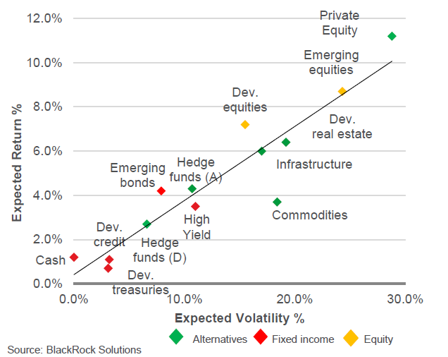
1. Determine Strategic Asset Allocation
I. Derive Asset Class Assumptions
B. Asset Class Forecasts
5 Year Risk and Return Assumptions
Source: BlackRock Solutions
Notes:
Notes
We can then combine our return forecasts with our forecast of risk for each asset class to rank asset accordingly.
-The chart below shows returns plotted against risk for the key asset classes1.
-The slope of the trend line can be viewed as a broad indicator of risk appetite, with the currently upward sloping trend line reiterating our view that risk is rewarded, even though the absolute level of expected returns is lower than in previous years.
-We note risk and return assumptions only tell part of the story. Assets with less attractive risk-adjusted returns can still provide important diversification benefits in an overall portfolio context.

Slide 22
1. Determine Strategic Asset Allocation
I. Derive Asset Class Assumptions
C. Asset Class Correlations
 | AUEQ | INEQ | INEQH | EMEQ | AUB | AUILB | INB | INCR | INHY | EMBH | AUREIT | INREIT | INFR
AUEQ | 1 | 0.5 | 0.8 | 0.7 | -0.1 | -0.1 | 0 | 0.1 | 0.4 | 0.2 | 0 | 0.1 | 0.1
INEQ | 0.5 | 1 | 0.7 | 0.6 | 0 | 0 | -0.2 | 0.1 | 0.2 | 0.1 | 0 | 0.5 | 0.5
INEQH | 0.8 | 0.7 | 1 | 0.7 | -0.2 | -0.2 | 0 | 0.1 | 0.5 | 0.3 | 0 | 0.2 | 0.2
EMEQ | 0.7 | 0.6 | 0.7 | 1 | -0.1 | -0.1 | -0.1 | 0 | 0.4 | 0.2 | 0 | 0.2 | 0.2
AUB | -0.1 | 0 | -0.2 | -0.1 | 1 | 0.7 | 0.7 | 0.4 | 0 | 0.2 | 0 | 0 | 0
AUILB | -0.1 | 0 | -0.2 | -0.1 | 0.7 | 1 | 0.6 | 0.3 | 0 | 0.1 | 0 | 0 | 0
INB | 0 | -0.2 | 0 | -0.1 | 0.7 | 0.6 | 1 | 0.6 | 0.3 | 0.2 | 0 | 0 | 0
INCR | 0.1 | 0.1 | 0.1 | 0 | 0.4 | 0.3 | 0.6 | 1 | 0.5 | 0.5 | 0 | 0 | 0
INHY | 0.4 | 0.2 | 0.5 | 0.4 | 0 | 0 | 0.3 | 0.5 | 1 | 0.6 | 0 | 0.1 | 0
EMBH | 0.2 | 0.1 | 0.3 | 0.2 | 0.2 | 0.1 | 0.2 | 0.5 | 0.6 | 1 | 0 | 0 | 0
AUREIT | 0 | 0 | 0 | 0 | 0 | 0 | 0 | 0 | 0 | 0 | 1 | 0 | 0
INREIT | 0.1 | 0.5 | 0.2 | 0.2 | 0 | 0 | 0 | 0 | 0.1 | 0 | 0 | 1 | 0.6
INFR | 0.1 | 0.5 | 0.2 | 0.2 | 0 | 0 | 0 | 0 | 0 | 0 | 0 | 0.6 | 1
Source: BlackRock, illustrative example only
Notes:
Notes
So now we have enough information to estimate the expected return of a multi asset portfolio. The return outcome is simply the expected return of the asset multiplied by the weighting of that asset in the strategic allocation.
In order to estimate the expected risk, not only do we need the stand alone risk of the asset, but we also need to understand how each asset behaves in respect of each other. For example, when equities fall, bonds prices can rise which may leave the portfolio return unchanged.
One way to measure this is via correlations. This table shows whether we believe assets are positively correlated (red) or zero or negatively correlated (green).
These are typically informed by historical correlation but we typically also impose some a fairly conservative forward looking overlay by assuming no negative correlations, which is why all the zeros in the table.
In practice we then convert correlation into covariance terms to estimate the variance of the portfolio.

Slide 23
1. Determine Strategic Asset Allocation
II. Build Candidate Portfolios on Efficiency Frontier
  Taking into account portfolio constraints & non-normal distributions
  Stress test results
High
Impossible strategies
Efficient strategies
Aggressive
Expected Reward
Inefficient strategies
Defensive
Low
Expected Risk
High
Source: BlackRock, illustrative example only
Notes:
Notes
Now we have all the ingredients to calculated both the expected return and expected risk of some candidate portfolios.
We can then create an efficiency frontier, ie the SAA mix with the highest return for a given level of risk.
In practice we call this the “Fuzzy frontier”
What this means is that potentially, there are many asset allocations which provide a similar expected return for a given level of risk (estimates are by no means precise, in fact we know for sure they will be exactly wrong!)
So we should first seek an asset allocation that lies within this range.
Change is costly: if the current strategic allocation is broadly efficient it might not be worth disturbing this for a debatable and marginal return enhancement.

Slide 24
Assessment Question
What drives most of the variability in fund returns (Strategic Allocation, Tactical Asset Allocation, Security Selection) and roughly what percentage
  Strategic Allocation; 60%
  Tactical Allocation; 75%
  Security Selection; 80%
  Strategic Allocation; 90%

Slide 25
2. Seek the most efficient active returns
  Determine the Active Risk Budget (or return target) eg. typically 2%– 4%
  Determine the split between Tactical Asset Allocation (TAA) & Stock Selection (SS)
  Choose the most efficient source of “alpha” for each asset class (ie. highest IR strategies)
The Fundamental Law of Active Management
Superior Risk Adjusted Returns (IR) = Skill X Breadth X Efficiency
Number of independent investment
decisions
Accuracy of
forecasts
Number of investment decisions
Quality of Portfolio
Construction
Find a game you can win, play it often and play it smart
Source: Grinold, R and Khan, R. (2000) Active Portfolio Management, 2nd edition: McGraw-Hill
Notes:
Notes
So now we have our candidate asset allocation mix, the next step is to determine how we can add value on top of this via some form of active management (either via stock selection or tactical allocation).
The first step is typically to decide how much risk are we prepared to spend to achieve these active returns.
Typically we find 2 – 4% is reasonable risk spend. The next question is, how much return can we achieve by taking this risk and how can we maximise the expected active return?
Thankfully we have a framework known as the Fundamental Law to help us here. This framework helps us determine how we can maximise risk adjusted returns (commonly referred to as the Information Ratio).
To maximise our risk adjusted returns we need to maximise 3 factors:
Skill in forecasting markets
Breadth (proxy for diversification)
Efficient implementation of active views taking into account portfolio constraints and transaction costs

Slide 26
2. Seek the most efficient active returns - example
Long-Only Manager: IR = 0.5 x 300 x 0.5 = 0.5
Long/Short Manager: IR = 0.5 x 300 x 0.8 = 0.8
Removing the long-only constraint
Maximum active stock position
Benchmark
Minimum active stock position
Large Capitalisation
Small Capitalisation
New Opportunities created
by allowing short positions
Source: BlackRock, illustrative example only
Notes:
Notes
This is an example of the Fundament Law in Practice. It can be applied to styles of management:
A standard “long-only” active equity strategy
Or strategy which allows shorting securities to take advantage of negative stock views known as Long/Short investing.
As you can see, both managers have equal skill and equal breadth (ASX 300 Universe), however the Long/Short manager has an advantage in terms of implementation, namely the ability to more fully express negative views.
So for a 2% risk spend, Manager 1 expects to deliver a 1.0% active return
Where as the Long/Short manager expects to deliver 1.6% active return
Which one would you choose?

Slide 27
2. Seek the most efficient active returns - example
Stock name | 12 month performance | ASX200 Weight (31-Dec-12) | Possible alpha in Long-Only portfolio (did not hold stocks) | Possible alpha in Long-Short portfolio (3% underweight)
Ten Network Holdings | -55% | 3bps | 1bps | 164bps
Fairfax Media Limited | -29% | 8bps | 2bps | 88bps
Newcrest Mining | -26% | 151bps | 40bps | 79bps
Billabong International | -41% | 3bps | 1bps | 124bps
Total Portfolio Contribution |  |  | 45bps | 455bps
Expressing negative stock views can add considerable value
Source: BlackRock, illustrative example only
For illustrative purposes only. This is not a recommendation to invest in any particular securities. The securities in the example were selected for the illustrative purposes. No analysis of their suitability was
conducted and no statement of opinion in relation to their suitability is provided. Past performance is not indicative of future performance.
Notes:
Notes
Here’s an example comparing Long-only investing with Long/Short.
If a manager has a negative view on a stock, the best that manager can do is not hold the stock resulting in an underweight to the benchmark.
A Long/Short manager can actually short the stock to express their negative view.
In this example the Long/Short manager added 455bps by expressing negative stock views vs the Long-only manager which only added 45bps.
Long/Short strategies have the additional advantage that they can produce positive returns when the overall market has negative returns (will explain in further detail).
This same framework can also be applied to Tactical Asset Allocation.

Slide 28
3. Construct Portfolio (combine Strategic Asset Allocation with alpha sources)
Traditional Portfolio
Implementation
  Exposure to Equity and Bond allocations gained via physical exposures
Other Assets
Property
Cash
Real assets
Traditional Equity
+1% Active Management
Australian - Large Cap
Australia – Small Cap
Value
Growth
International Equities
Emerging markets
  Active returns sourced via allocations to “long only” active strategies versus a beta benchmark
+0.75% Active
Management
Traditional Fixed Income
  Portfolio targets 1.5% active return for 3% active risk (IR 0.5)
  Active managers aim to “beat the benchmark”
  Market returns dominate overall portfolio return (95% of expected risk from Equities)
+ 2% Active Management
Sovereign Bonds
Corporates
High yield
Emerging markets
Source: BlackRock, illustrative example only
Notes:
Notes
Ok, so now we have our Strategic allocation mix, and we have also determined which form of active strategy will maximise our active returns for a given risk level.
Now we can combine both components to build the final portfolio.
For the SAA we would look for the most cost effective implementation, whether that is via holding physical securities or some form of derivative implementation (via futures or swaps).
The advantage of derivate implementation is that it is very capital efficient (only small amount of cash collateral is required), this cash then can be deployed to these more efficient forms of active management.
We can look to embed these long/short strategies across the various asset classes across the portfolio (equities or bonds) along with a dedicated allocation from cash to Long/Short or absolute return
As these strategies have the ability to produce positive returns in falling markets, they are a very useful diversification tool.

Slide 29
3. Construct Portfolio (combine Strategic Asset Allocation with alpha sources)
Traditional Portfolio + Alternatives
Implementation
  Physical Exposures implemented via derivatives to free up capital
Other Assets
Property
Cash
Real assets
Traditional Equity
Australian - Large Cap
Australia – Small Cap
Value
Growth
International Equities
Emerging markets
Passive Exposure
Traditional Fixed Income
Passive Exposure
Sovereign Bonds
Corporates
High yield
Emerging markets
Source: BlackRock, illustrative example only
Notes:
Notes
Ok, so now we have our Strategic allocation mix, and we have also determined which form of active strategy will maximise our active returns for a given risk level.
Now we can combine both components to build the final portfolio.
For the SAA we would look for the most cost effective implementation, whether that is via holding physical securities or some form of derivative implementation (via futures or swaps).
The advantage of derivate implementation is that it is very capital efficient (only small amount of cash collateral is required), this cash then can be deployed to these more efficient forms of active management.
We can look to embed these long/short strategies across the various asset classes across the portfolio (equities or bonds) along with a dedicated allocation from cash to Long/Short or absolute return
As these strategies have the ability to produce positive returns in falling markets, they are a very useful diversification tool.

Slide 30
3. Construct Portfolio (combine Strategic Asset Allocation with alpha sources)
Traditional Portfolio + Alternatives
Implementation
Multi Strategy
  Physical Exposures implemented via derivatives to free up capital
Other Assets
Equity Long/Short
Cash
Property
Cash
Real assets
Traditional Equity
+5%
Active
  Capital allocated to Alternative sources of alpha
+6%
Active
Australian - Large Cap
Australia – Small Cap
Value
Growth
International Equities
Emerging markets
+ 6% Active
Alternatives
Absolute Return
Alternative Assets
  Portfolio targets 2% active return for 2% active risk (IR 1)
  Active managers aim to provide “Absolute Returns”
  Portfolio less reliant on traditional beta exposures to drive returns
Passive Exposure
Passive Exposure
Passive Exposure
Traditional Fixed Income
Enhanced Equity
Passive Exposure
+6% Active
Sovereign Bonds
Corporates
High yield
Emerging markets
Passive Exposure
+6%
Active
Long / Short
Market neutral
FI Relative Value
Alternative Fixed Income
FI Relative Value
Flexible Fixed Income
Source: BlackRock, illustrative example only
Notes:
Notes
Ok, so now we have our Strategic allocation mix, and we have also determined which form of active strategy will maximise our active returns for a given risk level.
Now we can combine both components to build the final portfolio.
For the SAA we would look for the most cost effective implementation, whether that is via holding physical securities or some form of derivative implementation (via futures or swaps).
The advantage of derivate implementation is that it is very capital efficient (only small amount of cash collateral is required), this cash then can be deployed to these more efficient forms of active management.
We can look to embed these long/short strategies across the various asset classes across the portfolio (equities or bonds) along with a dedicated allocation from cash to Long/Short or absolute return
As these strategies have the ability to produce positive returns in falling markets, they are a very useful diversification tool.

Slide 31
Assessment Question
What does the fundamental law provide a framework for maximising?
  Information Ratio
  Total returns
  Sortino Ratio
What are the three key components of the fundamental law?
  Skill, breadth and efficiency
  Skill, breadth and talent
  Skill, depth and efficiency

Slide 32
4. Measure, Monitor and Manage Risk – Understand What you Own
Looking through a different lens
  Asset Class exposures can be decomposed into bundles of risk premia
Capital Allocation
Risk decomposition using macro risk factors
Current Portfolio
Current Portfolio
Source: BlackRock, illustrative example only
Notes:
Notes
We can also use different risk measurement techniques to look at portfolio risk through a different lens
While most investors believe their portfolios are diversified from a capital perspective, this may not be the case from a risk factor perspective eg. most portfolios are heavily exposure to “economic risk”
Viewing the portfolio through the risk factor lens may result in different portfolio allocation decisions and ultimately a more balanced portfolio

Slide 33
4. Measure, Monitor and Manage Risk – Stress Test & Scenario Analysis
Stress testing allows for analysis of the portfolio under historical downside events as well as a variety of future hypothetical scenarios
  Interest rate shocks: upward movement in rates hurts returns but is offset by the resulting rally in risk assets
  Inflation shocks: model the effects of changes in inflation on portfolio asset prices
Historical Stress Testing
Single-Factor Shocks
Regime Analysis: Inflation
Model the P&L effect on the portfolio of market conditions experienced under historical time periods
Considers the P&L implication on the
total portfolio of an upward movement in
US 10-Year rates at various magnitudes
Under hypothetical inflation, short-term rates increase and real assets rally. Deflation includes an equity slowdown and a decrease in interest rates
Source: BlackRock, illustrative example only
Notes:
Notes
We can also perform stress test on the portfolio allocation to understand how the portfolio will react in different market environments
For example we can stress test for scenarios that have occurred in the past, eg. Lehman collapse, Asian crisis etc
We can also stress test for hypothetical future scenarios, eg, rate rises or inflation shocks.
Ultimately there is no one risk measure that is the be all and end all, we should look at various risk measures to help inform our allocation decisions

Slide 34
Does this framework work?
BlackRock Wholesale Balanced Fund
Period | 1 Year | 3 Years | 5 Years | 10 Years
Quartile Ranking | 2 | 1 | 1 | 1
Peer Group Rank | 83 | 36 | 39 | 5
Peer Group Count | 230 | 212 | 185 | 145
Fund Performance | 8.7% | 14.7% | 8.3% | 7.3%
BlackRock Scientific Diversified Growth Fund
Period | 1 Year | 3 Years | 5 Years | 10 Years
Quartile Ranking | 1 | 1 | 1 | 1
Peer Group Rank | 39 | 8 | 8 | 22
Peer Group Count | 230 | 212 | 185 | 145
Fund Performance | 9.6% | 15.7% | 9.3% | 6.6%
Source: Morningstar Multi Sector Growth Universe, as of 31 December 2014. Performance figures have been calculated using a Morningstar methodology based on BlackRock raw data.
Notes:
Notes
I guess your probably all asking, all this theory may make sense, but does it work in practice?
The proof is in the pudding so to speak.
Our two balanced portfolios rank top quartile over most time periods in the Morningstar surveys
So this gives us a lot of confidence in our ability to construct well balanced portfolios.

Slide 35
Assessment Question
What is the purpose of implementing capital efficient & cost effective SAA?
  Free up capital for redeployment to active strategies
  Free up capital for redeployment to passive strategies
  Free up capital for redeployment to quantitative strategies

Slide 36
Learning Outcomes
2015 Investment Outlook
  Divergent sub-trend global growth
  Expect more muted asset class returns going forward
  Volatility & correlations may be higher challenging portfolio diversification
Portfolio Construction
  Strategic Allocation drives most of the portfolios returns
  Spend active risk budget wisely
  • Access cheap & cost effective beta
  • Utilise “efficient alpha” to diversify returns
  Measure, monitor and manage risk

Slide 37
Disclaimer
This presentation has been issued by BlackRock Investment Management (Australia) Limited ABN 13 006 165 975 AFSL 230 523 (BIMAL). BIMAL is the responsible entity and issuer of units in the BlackRock Wholesale Balanced Fund and BlackRock Scientific Diversified Growth Fund (the Funds). A Product Disclosure Statement (PDS) or disclosure document is available for the Funds and can be obtained by contacting us on 1300 366 100 or visit our website www.blackrock.com.au. You should obtain and consider the PDS or disclosure document before deciding whether to acquire, continue to hold or dispose of units in the Funds.
This presentation contains general information only and is not personal advice. This presentation is not intended to provide, and should not be relied upon, for accounting, legal, tax advice or investment recommendations. This presentation has been prepared without taking into account any person’s objectives, financial situation or needs. Before making any investment decision based on this document, a person should assess whether this presentation is appropriate having regard to the person’s objectives, financial situation and needs. A person should consult their financial, tax, legal, accounting or other professional advisor about the points raised in this presentation.
BIMAL, its officers, employees and agents believe that the information in this presentation and the sources on which the information is based (which may be sourced from third parties) are correct as at the date of this presentation. While every care has been taken in the preparation of this presentation, no warranty of accuracy or reliability is given and no responsibility for this information is accepted by BIMAL, its officers, employees or agents. Except where contrary to law, BIMAL excludes all liability for this information.
This presentation includes information marked as illustrations that are strictly for illustrative and educational purposes and is subject to change. Such information does not represent the actual current, past or future holdings or portfolio of any client of BIMAL.
Any investment is subject to investment risk, including delays on the payment of withdrawal proceeds and the loss of income or the principal invested. While any illustrations, examples, forecasts, estimates and opinions in this presentation are made on a reasonable basis, actual future results may differ materially from the illustrations, examples, forecasts, estimates and opinions set out in this presentation. BIMAL does not guarantee the repayment of capital or the performance of any product or rate of return referred to in this presentation. Past performance is not a reliable indicator of future performance.
This presentation is not a securities recommendation. This presentation is not intended as an offer or solicitation with respect to the purchase or sale of any securities in any jurisdiction.
No part of this publication may be reproduced in any manner without the prior written permission of BIMAL.
NOT FOR DISTRIBUTION. FOR WHOLESALE CLIENTS USE ONLY AND NOT FOR RETAIL CLIENTS.
©2015 BlackRock, Inc. All rights reserved.

